Slide 1








Lec-3
Identity and Access Management
University of Sialkot
Instructor：Muhammad Azeem

Slide 2
Contents:
Identity and Access?
Types of Users
Types of Identities
Introduction to IA Management (IAM)
IAM System Overview
IAM System Options

Slide 3


Identity and Access

Slide 4
Identity: Who are you?
Access: What you can use in the system
Identity is a role e.g. Father, Mother, Brother, Manager, Admin, User etc.
What you can see or do with the system e.g. read, write, delete etc.
However, product or company don’t care about it

Slide 5
Types of User

Slide 6
Types of Users
Across any organization there will be a variety of business roles that have different demands from the IT service due to the way they interact with different systems, handle data, travel, and use their identity to authorize transactions on behalf of the business, partners, and their customers.
Following are the user types and roles
Internal : Highly trusted people with delegated access
• Executives, managers, and knowledge workers that rely on IT systems for the majority of their work
• IT systems administrators, security, and compliance personnel implementing and maintaining the IT systems
• Frontline workforce interacting with technology as part of their work; may not have dedicated devices

Slide 7
Types of Users
External : Trusted business partners and guest user access
• Consultants, contractors, 3rd party business services adding value to the company but are not employees
• Temporary and guest user access to company IT systems during visits such as meetings
• Likely to use their own equipment and identities
Customer : Customers that require access to your services
• Consumers of systems and information published externally
• May be provided at no cost or paying a subscription for premium services

Slide 8
Types of Identities

Slide 9
Identities Types
The following list provides a high-level separation of identities to enable simple reference.
Local identities: These accounts are specific to the individual systems, such as Windows®, Mac®, and Linux® operating systems; any device that comes with a default set of credentials, as well as any applications that are not integrated with network or cloud identity services.
Network identities: The most prevalent solution for network identities is Microsoft® Active Directory® (AD). Many network systems can utilize this service to register their services and trust identities that are represented.
Cloud identities: With the popular adoption of cloud-based productivity services, most organizations now maintain one or more solutions that utilize cloud identities. For organizations using Microsoft Office 365®, their cloud identities are in Azure® Active Directory (Azure AD), a natural extension of AD.

Slide 10
IAM Concepts

Slide 11
IAM Concepts
There are several concepts that come up in every IAM design, each with their own approach and merit.
Least Privilege: This guidance ensures individuals only have the level of access they require to carry out the specific duties needed; permissions should be reviewed regularly.
Role Based Access Control: If you can define “roles,” you can assign controls and permissions to your identities based on those roles instead of each one having individual policies and other settings.
Just in Time Provisioning : Building upon the previous items above, when a role is assigned the rights to privileged access, this access is granted on demand and revoked automatically instead of being available at all times.

Slide 12
IAM Concepts
There are several concepts that come up in every IAM design, each with their own approach and merit.
Defense in Depth: An approach that is not only geared toward identity, but to securing your IT assets. This should include people, process, and every layer of the technology stack.
Zero Trust : The ultimate approach to security is to verify access requests at every stage of the journey, increasing the controls based on the user behavior and sensitivity of the system/data being accessed.
Passwordless Authentication : This is the removal of passwords from the authentication service. Due to the inherent vulnerabilities of passwords, and the cost to manage them, invest in alternatives such as certificates and biometrics.

Slide 13
IAM Overview

Slide 14
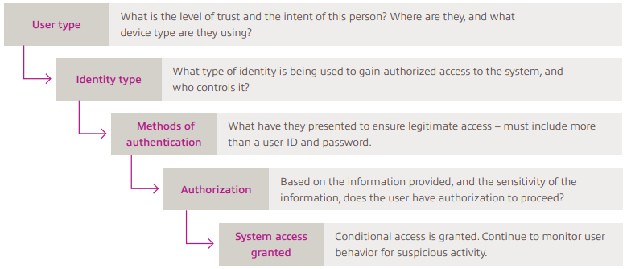
IAM System Overview
With an overview of the components involved and the approaches we can take, let’s now look at putting all this together to start mapping out the systems required to create a strong IAM solution.

Slide 15
IAM Options

Slide 16
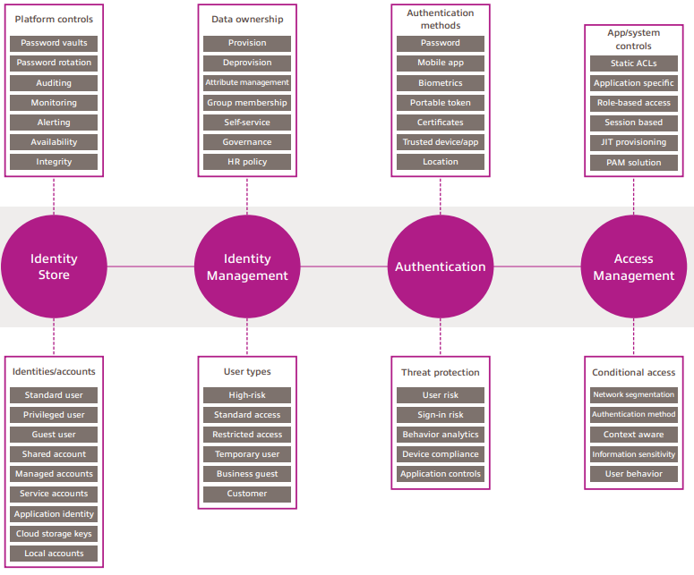
IAM Options

Slide 17
Thank You

